Slide 1
Deploying SharePoint Framework components to production
Deploy assets for production usage

Slide 2
Agenda
Package
Deploy to App Catalog
Install in a SharePoint site
Q&A

Slide 3
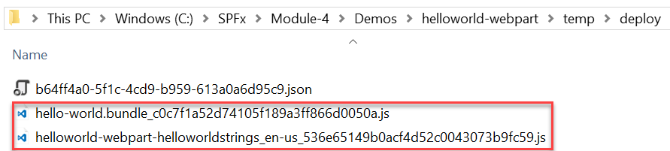
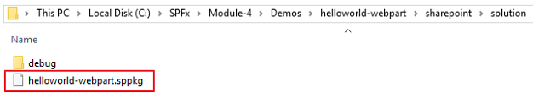
Package the web part
Use the bundle gulp task to build, localize, and bundle the project
Use the package-solution gulp task to package the project into a .sppkg file
The ship parameter build task creates a minified version of the bundle and copies all of the web part assets, including the web part bundle, into the temp\deploy folder. The .sppkg file is generated in the sharepoint\solution folder.
> gulp bundle --ship
> gulp package-solution --ship

Slide 4
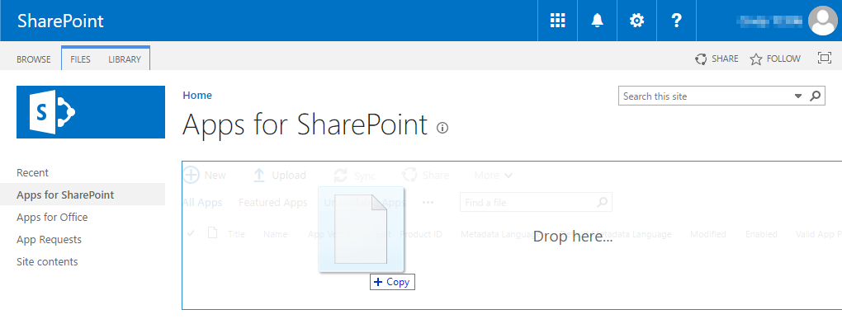
Deploy App to the SharePoint App Catalog
Go to your Office 365 App Catalog site
In the left sidebar, choose Apps for SharePoint
Upload the package (.sppkg file) for the web part

Slide 5
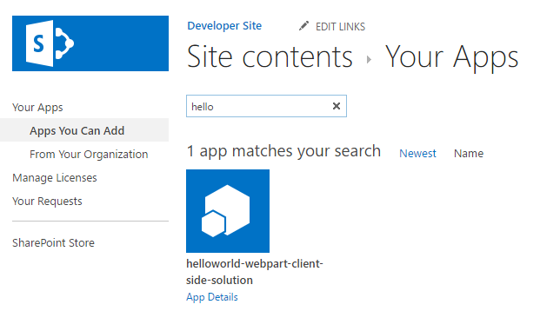
Install the App
Go to your Office 365 site
Add the App you just deployed to the SharePoint App Catalog

Slide 6
Deploy assets to a CDN and configure web part
At this point the web part will not run
You must first
deploy the web part assets to a CDN location
update the cdnBasePath in the write-manifests.json file
See the other sections in this module that describe how to
deploy to a SharePoint CDN and an Azure Storage CDN
update the cdnBasePath in the write-manifests.json file
{
"cdnBasePath": "<!-- PATH TO CDN -->"
}

Slide 7
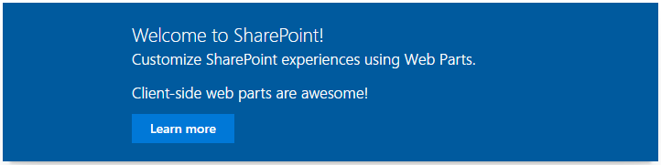
Add the web part to a SharePoint page
After the web part assets are deployed to a CDN location you can preview the web part
Create a page on your Office 365 site
Add the web part to the page

Slide 8
Summary
Package
Deploy to App Catalog
Install in a SharePoint site
Q&A

Slide 9
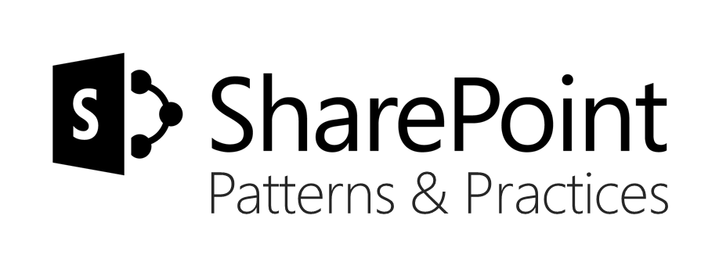
Sharing is caring…
Code samples and solutions
Reusable components
Guidance documentation
Monthly community calls
SharePoint Framework
SharePoint add-ins
Microsoft Graph
Office 365 APIs
http://aka.ms/SharePointPnP

Slide 10

Q&A

Slide 11


